Slide 1
CS4222
Principles of Database System
5. Normalization
Huiping Guo
Department of Computer Science
California State University, Los Angeles

Slide 2
Outline
Redundancies and anomalies
BCNF and test BCNF
Join-preserving decomposition
Dependency-preserving decomposition
Normalize a relation to BCNF
3NF
5. Normalization CS4222

Slide 3
Signs of bad database design
Redundancies
  Caused by FDs
  Lead to anomalies
    Insert anomalies
    Update anomalies
    Delete anomalies
5. Normalization CS4222

Slide 4
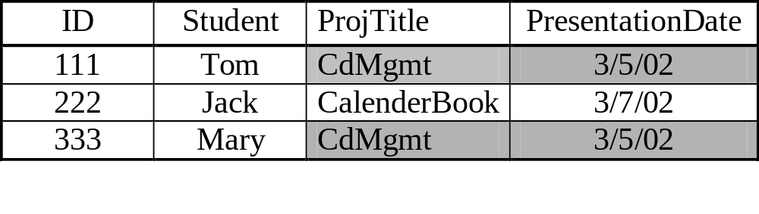
Examples: Redundancy due to FDs
FDs: ID → Student
Student → ProjTitle
ProjTitle →PresenationDate
Redundancy caused by ProjTitle→ PresenationDate
  ProjTitle is not a superkey
In general, some redundancy comes from the fact that there is a
FD: X→Y, while X is not a superkey.
5. Normalization CS4222

Slide 5
Redundancy leads to anomalies
Insertion Anomaly: how to insert that the presentation on multimedia databases has been set for 3/9/02 without associating any students first with the project.
Possible solution: use null values in the student field
5. Normalization CS4222

Slide 6
Redundancy leads to anomalies
Update Anomaly: if we modify presentation date for the CdMgmt project, we need to modify the date in each of the tuples in which it is stored (one per member). Otherwise, database will be inconsistent.
5. Normalization CS4222

Slide 7

Redundancy leads to anomalies
Delete Anomaly: how to delete student Jack who dropped out of the project without deleting information about the CalenderBook project.
Possible solution: use null values in the student field
5. Normalization CS4222

Slide 8
Null values
Null values cannot help eliminate redundant storage or update anomalies
Null values may address SOME insertion and delete anomalies, but they cannot address all of them.
  What if the associated fields are primary key?
5. Normalization CS4222

Slide 9
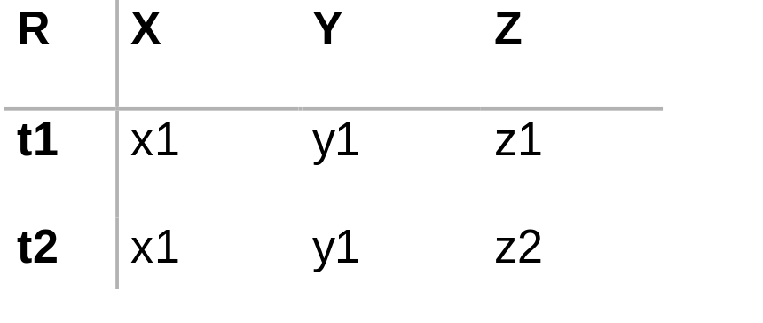
When does a relation contain no redundancy due to FDs?
Assume FD: X → Y
Since t1.X = t2.X, we have that t1.Y = t2.Y
  Redundancy, since we can deduce the value of t2.Y using FD
However, if X is a superkey of R, then it must be the case that t1.Z = t2.Z. Thus, t1 = t2 and hence there cannot be such a tuple t2 in R (a relation is a set).
Thus, a relation does not contain redundancy if for each FD X→ Y that holds on R if X is a superkey.
5. Normalization CS4222

Slide 10
Boyce Codd Normal Form
A relation R is in BCNF if, for every FD X→Y, one of the following statement is true
  X ⊇ Y; that is, it is a trivial FD, OR
  X is a superkey
Note:
  Need to check every FD
    Some FDs may not be directly given
  The Left side must be a superey
    Or the left side must contain a key
5. Normalization CS4222

Slide 11
Examples
Project(Id, student, ProjTitle, Date)
  ID→Student, student→ProjTitle, ProjTitle→Date
  NOT in BCNF
R1(Id, student), ID→Student
R2(student, ProjTitle), Student→ProjTitle
R3(ProjTitle, Date), ProjTitle→Date
➔ ALL in BCNF
5. Normalization CS4222

Slide 12
Testing for BCNF
For each functional dependency X → Y in F⁺, either Y is a subset of X or X is a superkey
Hence, to test for BCNF, we only need to test that for all functional dependencies X → Y in F⁺, either Y is a subset of X or X is a superkey.
5. Normalization CS4222

Slide 13
Steps of testing
List all FDs in F⁺
For each FD X→Y, compute X⁺
Check whether X⁺ contains all attributes
5. Normalization CS4222

Slide 14
Example1
Is R in BCNF?
R(A, B, C, D)
FD = {A→B, B → C, C → D, D → A}
A⁺= {A, B, C, D}
B⁺= {B, C, D, A}
C⁺= {C, D, A, B}
D⁺= {D, A, B, C}
R is in BCNF !
5. Normalization CS4222

Slide 15
Example2
R = {A, B, C, D}
FD = {A → B, B → C, C →D}
A⁺= {A, B, C, D}
B⁺= {B, C, D}
C⁺= {C, D}
D⁺= {D}
R is NOT in BCNF !
5. Normalization CS4222

Slide 16
Exercises
R(A, B, C, D)
F: AB→C, C→D, D→A
(AB)+ = (ABCD)
C+=(CDA)
R(A, B, C, D, E)
F: AB→C, C→D, D→B, D→E
(AB)+=(ABCDE)
C+ = (CDBE)
5. Normalization CS4222
Notes:
AB+={A,B,C,D,A}
C+={C,D,A} not in BCNF
AB+={A,B,C,DE}
C+={C,D,B,E} not in BCNF

Slide 17
Eliminating Redundancy
We can eliminate redundancy by decomposing a relation R containing redundancy into a set of relations (R1, R2, ..., Rn) such that each Ri is in BCNF.
Note:
  We further need to ensure that decomposed relations R1, R2, …, Rn represent the same information as R.
  That is, we can reconstruct R from R1, R2, …, Rn by taking their natural joins
5. Normalization CS4222

Slide 18
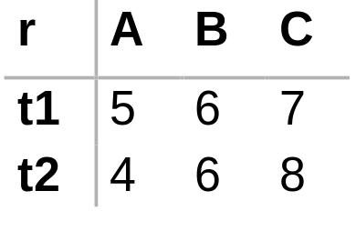
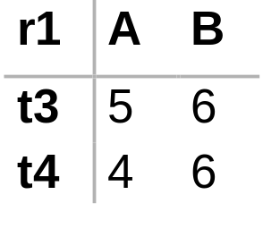
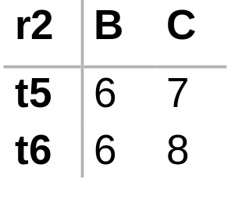
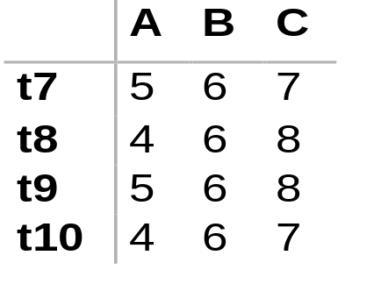
Lossless Join decomposition
r is a subset of r1 r2
hence it is lossy join decomposition!
5. Normalization CS4222

Slide 19
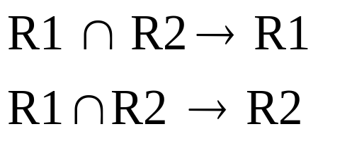
Testing for Lossless Join Decomposition
Let R be a relation with the set of functional dependencies F.
Let R1 and R2 be a decomposition of R.
The decomposition is lossless if and only if either of the following holds
The common attributes to R1 and R2 MUST contain a key for either R1 or R2
5. Normalization CS4222

Slide 20
Example
R (ABCD)
F = {A → C, B → D}
Decompose R into R1(AB) and R2(BCD)
R1 ∩ R2 = B
Is B a key of R1? No.
Is B a key of R2? No.
The decomposition is not lossless!
5. Normalization CS4222

Slide 21
Example
R (ABCD)
F = {AB → C, C→A, C →D}
Decompose R into R1(ACD) and R2(BC)
R1 ∩ R2 = C
Is C a key of R1? yes.
The decomposition is lossless!
5. Normalization CS4222

Slide 22
Projecting sets of FDs
Suppose we have a relation R and a set of FDs F.
Let S is a relation obtained by projecting R into a subset of the attributes of R
The projection of F on S (denoted F_{S} ) is the set of FDs that follow from F and hold in S
  Compute F⁺
  F_{S} is the set of all FDs in F⁺ that involve only the attributes in S
5. Normalization CS4222

Slide 23
Example
R(A,B,C,D)
F: A→B, B→C, C→D
Which FDs hold in S(A,C,D)?
F⁺={A→B, B→C, C→D,A→C, A→D, B→D}
F_{S} = {C→D, A→C, A→D}
5. Normalization CS4222

Slide 24
Normalize a relation to BCNF
Given: relation R, its set of functional dependencies F.
  For each BCNF violation X → Y of R, compute X⁺ (using F)
  Decompose R into X⁺ and X ∪ (R - X⁺)
  Project F onto the X⁺ and X ∪ (R - X⁺)
  Iterate on the two new relations
It is possible to have two different results following different sequences
The decomposition is lossless!
5. Normalization CS4222

Slide 25
Example 1
Project(student, ProjTitle, Date)
    Student→ProjTitle, ProjTitle→Date
    Candidate Key: {Student}
Pick BCNF violation: ProjTitle→Date
Compute ProjTitle⁺: ProjTitle, Date
Decomposed relations:
  R1(ProjTitle, Date)
  R2(Student, ProjTitle)
Project FDs onto R1 and R2:
  R1: ProjTitle→Date, no BCNF violation
    Candidate Key: {ProjTitle}
  R2: Student → ProjTitle, no BCNF violation
    Candidate Keys {Student}
5. Normalization CS4222
Notes:
18

Slide 26
Example 2
R = Drinkers(name, addr, beersLiked, manf, favoriteBeer)
F: name → addr
    name → favoriteBeer
    beersLiked → manf
    Candidate Key: {name, beersLiked}
Pick BCNF violation: name → addr.
Compute name’s closure: {name, addr, favoriteBeer}
Decomposed relations:
  Drinkers1(name, addr, favoriteBeer)
  Drinkers2(name, beersLiked, manf)
Project FDs:
  Drinkers1: name → addr
  name → favoriteBeer.
  Drinkers2: beersLiked → manf.
5. Normalization CS4222
Notes:
18

Slide 27
Example 2
BCNF violations?
  For Drinkers1, name is key and all attributs on the left side are superkey.
  For Drinkers2, {name, beersLiked} is the key, and beersLiked → manf violates BCNF
Decompose Drinkers2:
  Compute closure of beersLiked: {beersLiked, manf}
  Decompose:
  Drinkers3(beersLiked, manf)
  Drinkers4(name, beersLiked)
  Resulting relations are all in BCNF:
  Drinkers1(name, addr, favoriteBeer)
  Drinkers3(beersLiked, manf)
  Drinkers4(name, beersLiked)
5. Normalization CS4222
Notes:
20

Slide 28
BCNF decomposition: Some FDs are lost ☹
Some FDs may not be kept after the decompositions
Example:
R(title, theater, city)
  title, city → theater
  theater→city ➔ BCNF violation
Decompose
  R1(theater, city), R2(theater, title)
However, we lose FD: {title, city} → theater
  Since title and city are now in different relations.
5. Normalization CS4222

Slide 29
Functional Dependencies Preserving Decomposition
The decomposition of relation schema R with FDs F into schema with attribute sets X and Y is dependency-preserving if (F_{X} ∪ F_{Y})⁺ = F⁺
A dependency-preserving decomposition allows us to enforce all FDs by examining a single relation instance on each insertion or modification of a tuple
Decompositions to BCNF may NOT be dependency preserving
  BCNF is too strict
5. Normalization CS4222

Slide 30
Third Normal Form (3NF)
A relation R is in 3NF if, for every FD X→Y, one of the following statement is true
  X ⊇ Y; that is, it is a trivial FD, OR
  X is a superkey, OR
  Y is part of some key for R
A BCNF relation is also a 3NF relation
5. Normalization CS4222

Slide 31
Why 3NF?
Theorem: For any relation R and set of FD's F, we can find a decomposition of R into 3NF relations, such that
  these relations do not lose any information, and
  they can keep all FDs.
In other words, 3NF decomposition has two advantages:
  Lossless decomposition: natural join of new relations gives us the original relation back
  FD preserving
5. Normalization CS4222
Notes:
7

Slide 32
3NF example 1
R (title, theater, city)
  F: theater→city BCNF violation
  title, city → theater
R is not in BCNF
But R is in 3NF
  Candidate Keys: {theater, title} {title, city}
  Theater → city is BCNF violation
  City is part if the key
5. Normalization CS4222

Slide 33
3NF example 2
R (supplier, address, item, price)
F: supplier → address
supplier, item →price
Candidate key: {supplier, item}
R is not in 3NF
  For FD supplier → address, supplier is not a superkey, and address is not part of a candidate key
Since R is not in 3NF, it is not in BCNF.
5. Normalization CS4222

Slide 34
Testing 3NF
Given a relation R with FDs F, test if R is in 3NF.
  Compute all the candidate keys of R
  For each X→Y in F, check if it violates 3NF
    If X is not a superkey, and Y is not part of a candidate key, then X→Y violates 3NF.
5. Normalization CS4222
Notes:
7

Slide 35
Algorithm: Normalize R into 3NF
Step 0: Get all the candidate keys
Step 1: Merge FDs with the same left-hand side.
Step 2: Minimize F and get the minimal cover F’
Step 3: For each X →Y in F’, create a relation with
schema XY
Step 4: Eliminate a relation schema that is a subset of
another.
Step 5: If no relations contain a candidate key of R, create a relation to include a candidate key of R.
5. Normalization CS4222
Notes:
16

Slide 36
Example 1
R = ABCD, F = {A → B, B → C, AC → D}
Step 0: Candidate key: {A}
Step 1: nothing
Step 2: Minimal cover F’ = {A → B, B → C, A → D}
Step 3: create relations:
  For A→B, create a relation R1(A,B)
  For B→C, create a relation R2(B,C)
  For A→D, create a relation R3(A,D)
Step 4: do nothing
Step 5: do nothing, since candidate key A is in A→B
Result: R1(A,B), R2(B,C), R3(A,D)
5. Normalization CS4222
Notes:
17
A→C
A→AC
AC→D
A→D

Slide 37
Example 2
R = ABCDE, F = {AB→CD, C→A}
Step 0: Candidate key: {ABE} {CBE}
Step 1: nothing
Step 2: nothing
Step 3: create relations:
  For AB→CD, create a relation R1(A, B, C, D)
  For C→A, create a relation R2(A,C)
Step 4: eliminate R2, since its attributes are a subset of R1.
Step 5: Since R1 does not include a candidate key of R, create a table R3(A,B,E) to include a candidate key of R.
Result:
  R1(A,B,C,D)
  R3(A,B,E)
5. Normalization CS4222
Notes:
17

Slide 38




Example 3
R(A,B,C,D,E,F,G,H)
F = {A→B, ABCD→E, EF→G, EF→H, ACDF→EG}
step 1: F1 = {A→B, ABCD→E, EF → GH, ACDF → EG}
step 2:
  Remove attribute B from LHS of ABCD→E
  Remove E from RHS of ACDF→EG
  Remove ACDF →G
  Result: F2 = {A → B, ACD → E, EF → GH}
  Candidate key: {ACDF}
Step 3: create relations:
  A→B: create a relation R1(A, B)
  ACD→E: create a relation R2(A, C, D, E)
  EF→GH: create a relation R3(E, F, G, H)
Step 4: do nothing
Step 5: ACDF is a candidate key, so create a relation R4(A,C,D,F)
Result: R1(A,B), R2(A,C,D,E), R3(E,F,G,H), R4(A,C,D,F)
5. Normalization CS4222

Slide 39
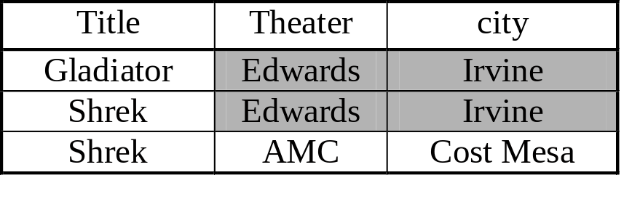
Comparing BCNF and 3NF
BCNF decomposition can keep info, but not FDs
3NF decomposition can keep both.
3NF can still have some redundancy. Example:
  R(title, theater, city) theater→city
  title, city → theater
“Edwards” and “Irvine” are repeated.
In most cases, we prefer 3NF than BCNF.
5. Normalization CS4222

